Slide 1
Logistic Regression
Elsayed Hemayed
The original slides are from EMC Data Analytics Course and from Udmey course by SuperDataScience Team

Slide 2
Overview of Logistic Regression
Why we need logistics regression
Technical description of a logistics regression model
Interpretation and scoring with the logistics regression model
Diagnostics for validating the logisitics regression model
The Reasons to Choose (+) and Cautions (-) of the logistics regression model

Slide 3
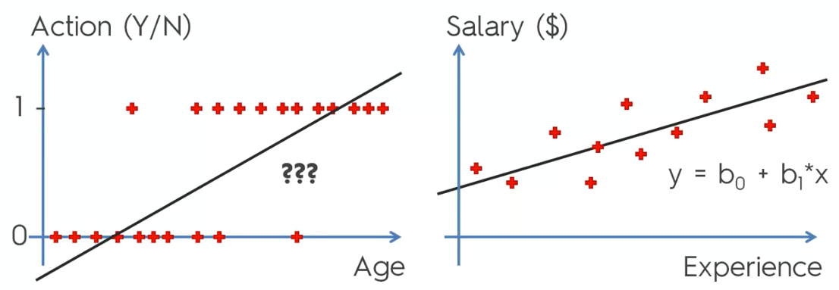
Why Logistic Regression?

Slide 4
Linear Model Plot
p
LP Model
1
0
age

Slide 5
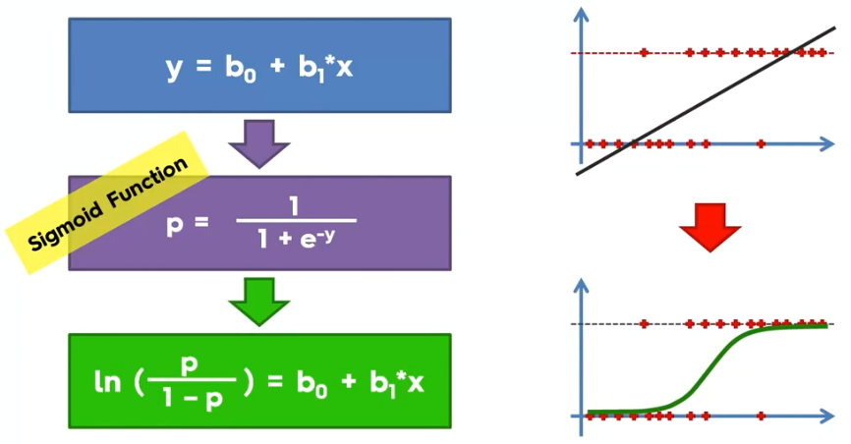
Logistic Regression

Slide 6
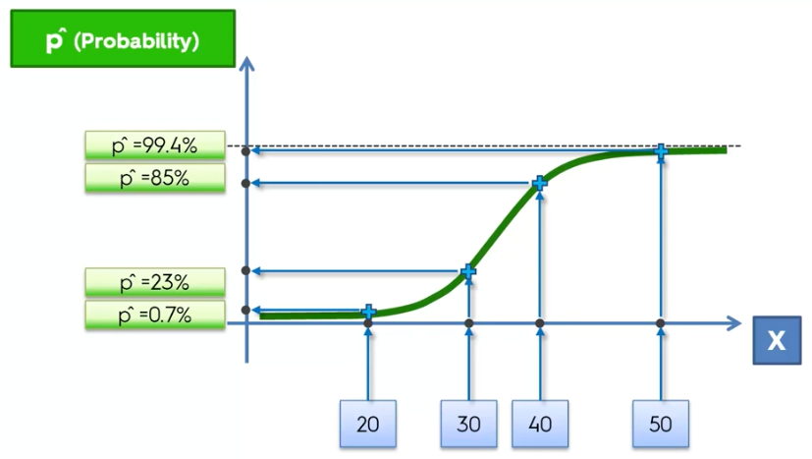
Predicted P

Slide 7
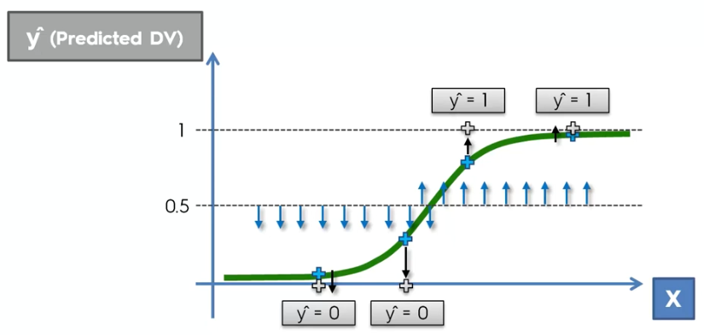
Predicted y

Slide 8
Examples of Binary Outcomes
Should a bank give a person a loan or not?
Is an individual transaction fraudulent or not?
Which people are more likely to vote against a new law?
Which customers are more likely to buy a new product?

Slide 9
Data for Example: Customers’ Subscription
We have data on 1,000 random customers from a given city. We want to know what determines their decision to subscribe to a magazine.
Subscribe: indicates if a customer has subscribed to the magazine.
Ages: we will start by examining how age influences the likelihood of subscription.
Gender: May also influence likelihood of subscription.

Slide 10
A linear model
Subscribe = b₀ + b₁ age + ε
P(subscribe=1) = p = -1.700 + 0.064 age
Every additional year of age increase the probability of subscription by 6.4%
 | Coefficient
Const | -1.70073
age | 0.0645

Slide 11
Problems with the Linear Approach
Probabilities should be bounded 0 <= p <= 1
The range of age is the data 20<= age <=55
P(Subscribe =1 | age = 25) = -1.7 + 0.064 x 25 = -0.09 (<0)
P(Subscribe =1 | age = 45) = -1.7 + 0.064 x 45 = 1.2 (>1)

Slide 12
Fixing the Linear Model
p=f(age)
What f to use
f(.) must be >=0
f(.) must be <=1
(to be >=0)
p=exp(b₀ + b₁ age) = e^{(b0 + b1 age)}
(To be <=1)
p= exp(b₀ + b₁ age) / (exp(b₀ + b₁ age) +1)

Slide 13
Logistics Regression
p= exp(b₀ + b₁ age) / (exp(b₀ + b₁ age) +1)
Can be rewritten as
ln (p/(1-p)) = b₀ + b₁ age
The ln term is called the logit
And the ratio (p/(1-p)) is called the odd ratio

Slide 14
A Logistics model
ln (p/(1-p)) = b₀ + b₁ age
ln (p/(1-p)) = b₀ + b₁ age = -26.524 + 0.78 age
Or
p= exp(b₀ + b₁ age) / (exp(b₀ + b₁ age) +1)
 | Coefficient
Const | -26.524
age | 0.78105

Slide 15
A Logistics model
ln (p/(1-p)) = b₀ + b₁ age
ln [p/(1-p)] = b₀ + b₁ age = -26.524 + 0.78 age
So
For every unit increase in age, ln [p/(1-p)] increases by 0.78 units.
For age =35; y* = ln [p/(1-p)] =0.813
p = exp (y*)/[exp(y*)+1] = P (subscribe =1 | age =35) = 0.693
 | Coefficient
Const | -26.524
age | 0.78105

Slide 16
A logistics model results
Change in p from age = 35 to 36 is 0.138
Change in p from age= 25 to 26 is 0.001
Change in p from age 45 to 46 is 0.0001

Slide 17
Comparing Linear and Logit Models
p
LP Model
1
Logit Model
0
age

Slide 18
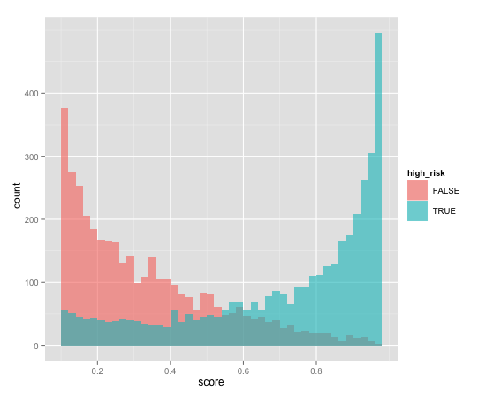
An Interesting Fact About Logistic Regression
"The probability mass equals the counts"
If 13% of our loan risk training set defaults then
The sum of all the training set scores will be 13% of the number of training examples
Logistic regression returns a score that estimates the probability that a borrower will default.
Blue = defaulters
Red = non defaulters
Notes:
"Logistic regression preserves summary statistics of the training data" – in other words, logistic regression is a very good way of concisely describing the probability of all the different possible combination of features in the training data.
Two examples of this feature are shown in the slide. If you sum up everybody’s score after putting them through the model the total computed will be equal to the sum of all the training set scores.
What this means is that it is almost like a continuous look up probability table. Assume that we have all categorical variables and you have the table of probability of every possible combination of variables, Logistic regression is a concise version of the table. This is what can be defined as a “well calibrated” model.
Reference: http://www.win-vector.com/blog/2011/09/the-simpler-derivation-of-logistic-regression/

Slide 19
Diagnostics
Hold-out data:
Does the model predict well on data it hasn't seen?
N-fold cross-validation: Formal estimate of generalization error
"Pseudo-R²" : 1 – (deviance/null deviance)
Deviance, null deviance both reported by most standard packages
The fraction of "variance" that is explained by the model
Used the way R² is used
Notes:
This is all very similar to linear regression. We use the hold-out data method, and N-fold cross validation on the fitted model. This is exactly what we did with linear regression to determine if the model predicts well.
The model should explain more than just this simple guess. Pseudo R² is the term we use in Logistic regression which we use the same way we use R² in linear regression. It is basically “the fraction” of the variance .
Deviance, for the purposes of this discussion, is analogous to "variance" in linear regression.
The null deviance is the deviance (or "error') that you would make if you always assumed that the probability of true were simply the global probability.
1 – (deviance/null deviance) is the “fraction” that defines Pseudo R² which is a measure of how well the model explains the data.

Slide 20
Diagnostics (Cont.)
Sanity check the coefficients
Do the signs make sense? Are the coefficients excessively large?
Wrong sign is an indication of correlated inputs, but doesn't necessarily affect predictive power.
Excessively large coefficient magnitudes may indicate strongly correlated inputs; you may want to consider eliminating some variables, or using regularized regression techniques.
Unfortunately, regularized logistic regression is not standard.
Infinite magnitude coefficients could indicate a variable that strongly predicts a subset of the output (and doesn't predict well on the rest).
Try a Decision Tree on that variable, to see if you should segment the data before regressing.
Notes:
The sanity checks are exactly the same as what we discussed in linear regression.
Once we determine the fit is good we need to perform the sanity checks. Logistic regression is an explanatory model and the coefficients provide the required details.
First check the sign of the coefficients. Do the signs make sense. For example, should the income increase with age or years of education? The coefficients should be positive. If not there might be something wrong. It is often an indicator that the variables are correlated to each other. Regression works best if all the drivers are independent. This does not in fact affect the predictive power but the explanatory capability is compromised here.
We also need to check if the magnitude of the coefficients make sense? They sometimes can become excessively large and we prefer them not to be very large. This is also an indication of strongly correlated inputs. In this case consider eliminating some variables. Note that unlike linear regression, where we have regularized regression techniques, there are not any standard methods with logistic regression. If there is a requirement one should implement one’s own method.
Sometimes you may get infinite magnitude coefficients which could indicate that there is a variable that strongly predicts a certain subset of the output and does not predict well on the rest. For example there is a range of age for which the output income is perfectly predicted. In such conditions plot the output vs. the input and determine the segment at which the prediction goes wrong. We should then segment the data before fitting the model. Decision Trees can be used on that variable, to see if you should segment the data before regressing.

Slide 21
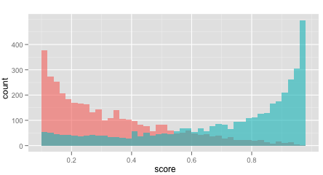
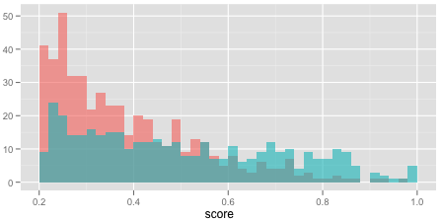
Diagnostics: Plot the Histograms of Scores
good separation
Notes:
The next diagnostic method is plotting the histogram of the scores. The graph in the top half is what we saw earlier in the lesson. The graph tells us how well the model discriminates true instances from false instances. Ideally, true score high and false instances score low. If so, most of the mass of the two histograms are separated. That is what you see in the graph at the top.
The graph shown at the bottom shows substantial overlap. The model did not predict well. This means the input variables are not strong predictors of the output.

Slide 22
Logistic Regression - Reasons to Choose (+) and Cautions (-)
Reasons to Choose (+) | Cautions (-)
Explanatory value: Relative impact of each variable on the outcome in a more complicated way than linear regression | Does not handle missing values well
Robust with redundant variables, correlated variables Lose some explanatory value | Assumes that each variable affects the log-odds of the outcome linearly and additively Variable transformations and modeling variable interactions can alleviate this A good idea to take the log of monetary amounts or any variable with a wide dynamic range
Concise representation with the the coefficients | Cannot handle variables that affect the outcome in a discontinuous way. Step functions
Easy to score data | Doesn't work well with discrete drivers that have a lot of distinct values For example, ZIP code
Returns good probability estimates of an event
Preserves the summary statistics of the training data "The probabilities equal the counts"
Notes:
Logistic regressions have the explanatory values and we can easily determine how the variables affect the outcome. The explanatory values are a little more complicated than linear regression. It works well with (robust) redundant variables and correlated variables. In this case the prediction is not impacted but we lose some explanatory value with the fitted model. Logistic regression provides the concise representation of the outcome with the coefficients and it is easy to score the data with this model. Logistic regression returns probability estimates of an event. It also returns calibrated model it preserves the summary statistics of the training data.
Cautions (-) are that the Logistic regression does not handle missing values well. It assumes that each variable affects the log odds of the outcome linearly and additively. So if we have some variables that affect the outcome non-linearly and the relationships are not actually additive the model does not fit well.
Variable transformations and modeling variable interactions can address this to some extent. It is recommended to take the log of monetary amounts or any variable with a wide dynamic range. It cannot handle variables that affect the outcome in a discontinuous way. We discussed the issue of infinite magnitude coefficients earlier where the prediction is inconsistent in ranges. Also when you have discrete drivers with a large number of distinct values the model becomes complex and computationally inefficient.

